Slide 1

Introduction to MySQL
A Comprehensive Guide for Data Analysts

Slide 2

What Is a Database?
Database definition
A database is an organized collection of structured information, or data, typically stored electronically in a computer system. A database is usually controlled by a database management system (DBMS). Together, the data and the DBMS, along with the applications that are associated with them, are referred to as a database system, often shortened to just database.
Data within the most common types of databases in operation today is typically modeled in rows and columns in a series of tables to make processing and data querying efficient. The data can then be easily accessed, managed, modified, updated, controlled, and organized. Most databases use structured query language (SQL) for writing and querying data.
Notes:
Notes to presenter:
What is a Tableau?.
Include information about the topic
Details about the topic will also be helpful here.
Tell the story of your learning experience. Just like a story there should always be a beginning, middle and an end.
On the other side, you can add a graphic that provides evidence of what you learned.
Feel free to use more than one slide to reflect upon your process. It also helps to add some video of your process.

Slide 3
What is Structured Query Language (SQL)?
SQL is a programming language used by nearly all relational databases to query, manipulate, and define data, and to provide access control. SQL was first developed at IBM in the 1970s with Oracle as a major contributor, which led to implementation of the SQL ANSI standard, SQL has spurred many extensions from companies such as IBM, Oracle, and Microsoft. Although SQL is still widely used today, new programming languages are beginning to appear.
Notes:
Notes to presenter:
Description of what you learned in your own words on one side.
Include information about the topic
Details about the topic will also be helpful here.
Tell the story of your learning experience. Just like a story there should always be a beginning, middle and an end.
On the other side, you can add a graphic that provides evidence of what you learned.
Feel free to use more than one slide to reflect upon your process. It also helps to add some video of your process.

Slide 4
What’s the difference between a database and a spreadsheet?
Databases and spreadsheets (such as Microsoft Excel) are both convenient ways to store information. The primary differences between the two are:
How the data is stored and manipulated
Who can access the data
How much data can be stored
Spreadsheets were originally designed for one user, and their characteristics reflect that. They’re great for a single user or small number of users who don’t need to do a lot of incredibly complicated data manipulation. Databases, on the other hand, are designed to hold much larger collections of organized information—massive amounts, sometimes. Databases allow multiple users at the same time to quickly and securely access and query the data using highly complex logic and language.
Notes:
Notes to presenter:
Description of what you learned in your own words on one side.
Include information about the topic
Details about the topic will also be helpful here.
Tell the story of your learning experience. Just like a story there should always be a beginning, middle and an end.
On the other side, you can add a graphic that provides evidence of what you learned.
Feel free to use more than one slide to reflect upon your process. It also helps to add some video of your process.

Slide 5
What is database software?
Database software is used to create, edit, and maintain database files and records, enabling easier file and record creation, data entry, data editing, updating, and reporting. The software also handles data storage, backup and reporting, multi-access control, and security. Strong database security is especially important today, as data theft becomes more frequent. Database software is sometimes also referred to as a “database management system” (DBMS).
Database software makes data management simpler by enabling users to store data in a structured form and then access it. It typically has a graphical interface to help create and manage the data and, in some cases, users can construct their own databases by using database software.
Notes:
Notes to presenter:
Description of what you learned in your own words on one side.
Include information about the topic
Details about the topic will also be helpful here.
Tell the story of your learning experience. Just like a story there should always be a beginning, middle and an end.
On the other side, you can add a graphic that provides evidence of what you learned.
Feel free to use more than one slide to reflect upon your process. It also helps to add some video of your process.

Slide 6
What is a database management system (DBMS)?
A database typically requires a comprehensive database software program known as a database management system (DBMS). A DBMS serves as an interface between the database and its end users or programs, allowing users to retrieve, update, and manage how the information is organized and optimized. A DBMS also facilitates oversight and control of databases, enabling a variety of administrative operations such as performance monitoring, tuning, and backup and recovery.
Some examples of popular database software or DBMSs include MySQL, Microsoft Access, Microsoft SQL Server, FileMaker Pro, Oracle Database, and dBASE.
Notes:
Notes to presenter:
Description of what you learned in your own words on one side.
Include information about the topic
Details about the topic will also be helpful here.
Tell the story of your learning experience. Just like a story there should always be a beginning, middle and an end.
On the other side, you can add a graphic that provides evidence of what you learned.
Feel free to use more than one slide to reflect upon your process. It also helps to add some video of your process.

Slide 7
What is a MySQL database?
MySQL is an open-source relational database management system based on SQL. It was designed and optimized for web applications and can run on any platform. As new and different requirements emerged with the internet, MySQL became the platform of choice for web developers and web-based applications. Because it’s designed to process millions of queries and thousands of transactions, MySQL is a popular choice for ecommerce businesses that need to manage multiple money transfers. On-demand flexibility is the primary feature of MySQL.
MySQL is the DBMS behind some of the top websites and web-based applications in the world, including Airbnb, Uber, LinkedIn, Facebook, Twitter, and YouTube
Notes:
Notes to presenter:
Description of what you learned in your own words on one side.
Include information about the topic
Details about the topic will also be helpful here.
Tell the story of your learning experience. Just like a story there should always be a beginning, middle and an end.
On the other side, you can add a graphic that provides evidence of what you learned.
Feel free to use more than one slide to reflect upon your process. It also helps to add some video of your process.

Slide 8
SQL
SQL stands for Structured Query Language. It is used for storing and managing data in relational database management system (RDMS). In RDBMS data stored in the form of the tables.
It is a standard language for Relational Database System. It enables a user to create, read, update and delete relational databases and tables.
All the RDBMS like MySQL, Informix, Oracle, MS Access and SQL Server use SQL as their standard database language.
SQL allows users to query the database in a number of ways, using English-like statements.
SQL is mostly used by engineers in software development for data storage. Nowadays, it is also used by data analyst for following reason:
Notes:
Notes to presenter:
Description of what you learned in your own words on one side.
Include information about the topic
Details about the topic will also be helpful here.
Tell the story of your learning experience. Just like a story there should always be a beginning, middle and an end.
On the other side, you can add a graphic that provides evidence of what you learned.
Feel free to use more than one slide to reflect upon your process. It also helps to add some video of your process.

Slide 9
SQL Statement Rules:
SQL follows the following rules:
SQL stands for Structured Query Language. It is used for storing and managing data in relational database management system (RDMS). In RDBMS data stored in the form of the tables.
It is a standard language for Relational Database System. It enables a user to create, read, update and delete relational databases and tables.
All the RDBMS like MySQL, Informix, Oracle, MS Access and SQL Server use SQL as their standard database language.
SQL allows users to query the database in a number of ways, using English-like statements.
SQL is mostly used by engineers in software development for data storage. Nowadays, it is also used by data analyst for following reason:
Notes:
Notes to presenter:
Description of what you learned in your own words on one side.
Include information about the topic
Details about the topic will also be helpful here.
Tell the story of your learning experience. Just like a story there should always be a beginning, middle and an end.
On the other side, you can add a graphic that provides evidence of what you learned.
Feel free to use more than one slide to reflect upon your process. It also helps to add some video of your process.

Slide 10
What are data types?
Every column in a table has a data type. These data types are defined by SQL or Structured Query Language. A data type defines the type of value that can be stored in a table column.
For example, here are some of the data types that are available:
Numeric data types such as INT, TINYINT, BIGINT, FLOAT, REAL.
Date and time data types such as DATE, TIME, DATETIME.
Character and string data types such as CHAR, VARCHAR.
Notes:
Notes to presenter:
Description of what you learned in your own words on one side.
Include information about the topic
Details about the topic will also be helpful here.
Tell the story of your learning experience. Just like a story there should always be a beginning, middle and an end.
On the other side, you can add a graphic that provides evidence of what you learned.
Feel free to use more than one slide to reflect upon your process. It also helps to add some video of your process.

Slide 11
What is database structure?
Database structure refers to how data is arranged in a database. Within a database, related data are grouped into tables, each of which consists of rows (also called tuples) and columns, like in a spreadsheet.
The structure of a database consists of a set of key components. These include:
Tables or entities, where the data is stored.
Attributes which are details about the table or entity. In other words, attributes describe the table.
Fields, which are columns used to capture attributes.
A record, which is one row of details about a table or entity.
And the primary key, which is a unique value for an entity.
Notes:
Notes to presenter:
Description of what you learned in your own words on one side.
Include information about the topic
Details about the topic will also be helpful here.
Tell the story of your learning experience. Just like a story there should always be a beginning, middle and an end.
On the other side, you can add a graphic that provides evidence of what you learned.
Feel free to use more than one slide to reflect upon your process. It also helps to add some video of your process.

Slide 12
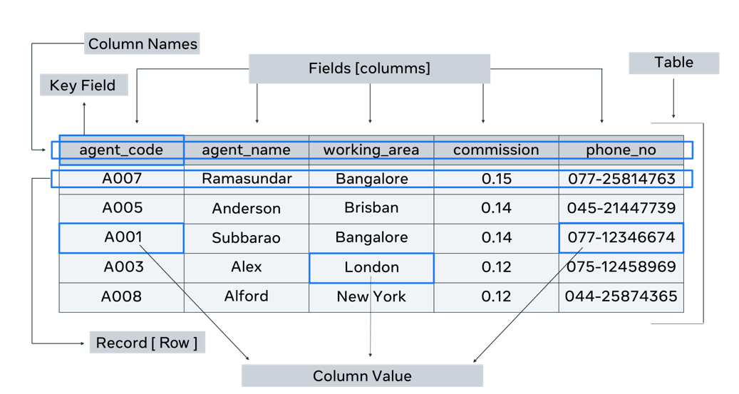
What is database structure?
Database structure refers to how data is arranged in a database. Within a.
Notes:
Notes to presenter:
Description of what you learned in your own words on one side.
Include information about the topic
Details about the topic will also be helpful here.
Tell the story of your learning experience. Just like a story there should always be a beginning, middle and an end.
On the other side, you can add a graphic that provides evidence of what you learned.
Feel free to use more than one slide to reflect upon your process. It also helps to add some video of your process.

Slide 13
What is database structure?
Table
A table contains all the fields, attributes and records for a type of entity. A database will most probably contain more than one table.
Fields
Column headings are known as fields. Each field contains a different attribute. For every table, a unit of data is entered into each field. It’s also known as a column value. Each column has a data type. For example, the “agent_name” column has a data type of text, and the “commission” column has a numeric data type.
Column value or unit of data
Each individual piece of data entered into a column is a unit of data. These units are also called data elements or column values.
Records
A record consists of a collection of data for each entity. It’s also known as a row in the table.
Notes:
Notes to presenter:
Description of what you learned in your own words on one side.
Include information about the topic
Details about the topic will also be helpful here.
Tell the story of your learning experience. Just like a story there should always be a beginning, middle and an end.
On the other side, you can add a graphic that provides evidence of what you learned.
Feel free to use more than one slide to reflect upon your process. It also helps to add some video of your process.

Slide 14
Primary Key
A primary key in SQL is a unique identifier for each record in a database table. It ensures that each row in the table is uniquely identifiable, meaning no two rows can have the same primary key value. A primary key is composed of one or more columns, and it must contain unique values without any NULL entries. The primary key enforces entity integrity by preventing duplicate records and ensuring that each record can be precisely located and referenced, often through foreign key relationships in other tables. Using a primary key is fundamental for establishing relationships between tables and maintaining the integrity of the data model.
Notes:
Notes to presenter:
Description of what you learned in your own words on one side.
Include information about the topic
Details about the topic will also be helpful here.
Tell the story of your learning experience. Just like a story there should always be a beginning, middle and an end.
On the other side, you can add a graphic that provides evidence of what you learned.
Feel free to use more than one slide to reflect upon your process. It also helps to add some video of your process.

